Slide 1


PORTFOLIO
Benjamin menares.
Business and data analyst

Slide 2
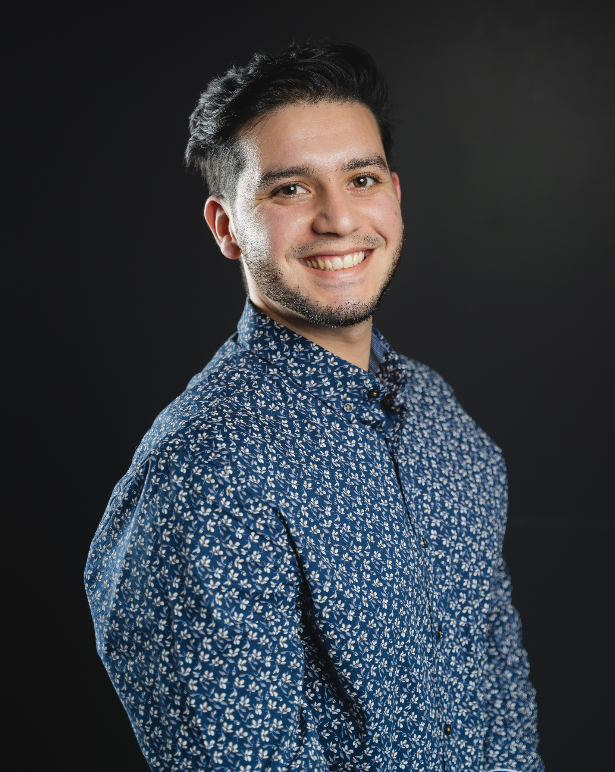
INTRODUCTION
Let’s go through a journey from:
How I started my career
How I applied a variety of engineering disciplines
Personal Phrase
I like to see every problem or obstacle, as an improvement opportunity

Slide 3




Roadmap
Ben in the Future
Experience
Skills
Education
time

Slide 4
Education

Slide 5






EDUCATION
Bachelor’s and Master’s Degree in
Engineering
Universidad Adolfo Ibañez
2019
Certificates:
Data Science with Python
University of Michigan, Coursera
2022
Jun
2023
Certificate: Effective Presentation
Business Administration Diploma
ILAC International College
Oct
2023

Slide 6
Experience

Slide 7





PRODUCT MANAGER
Product
Management
Sales &
Marketing
Data
Governance
Suppliers &
Logistics
Data
Analysis
B2B
Office Supplies
Projects:
Training platform for the sales department
Standardization of product description in SAP
Food box production (covid 19 aid)
Achievements:
Surpassed by
10%
Division Objective
Enhanced
80%
Product Data in SAP
Delivered on Time
100%
Food aid boxes for covid19

Slide 8



BUSINESS ANALYST
Process
Optimization
Web
Management
Project
Development
Logistics
Data
Analysis
Data
Governance
B2B
Food Packaging Distributor
Projects:
E-commerce Development
ERP implementation
Standarization of product description
Marketplace integration
Achievements:
Increased
10%
Sales by clustering customers
Boosted by
20%
Customer recapture
Increased by
10%
New customers
Enhanced by
30%
Sales process

Slide 9



CUSTOMER SUCCESS ENGINEER
Customer
Portfolio
Algorithm
Optimization
Project
Development
IT &
Development
Data
Analysis
B2B
Route Optimization
Software
Projects:
Routing Algorithm improvement
Software Development: rescue system
Achievements:
Boosted by
40%
Software usage in customer users
Improved
40%
Data extractions and Query performance
Amended by
30%
Location time stamp accuracy
Enhanced
43%
Forecasting

Slide 10


BARISTA
Customer
Recomendations
Prepare
delightful
coffee
Achievements:
Mantained
97.5%
Customer Satisfaction
Reduced to
2%
Leftovers
Reduced
30%
Closing time

Slide 11
Skills

Slide 12











Hard Skills:
Data Analysis
Data Base Management
Project Management and Collaboration tools

Slide 13






Hard Skills:
ERPs
Process Modeling
API and other integration tools

Slide 14





SOFT SKILLS
Team player
Adaptabilty
Attention
to detail
Communication

Slide 15


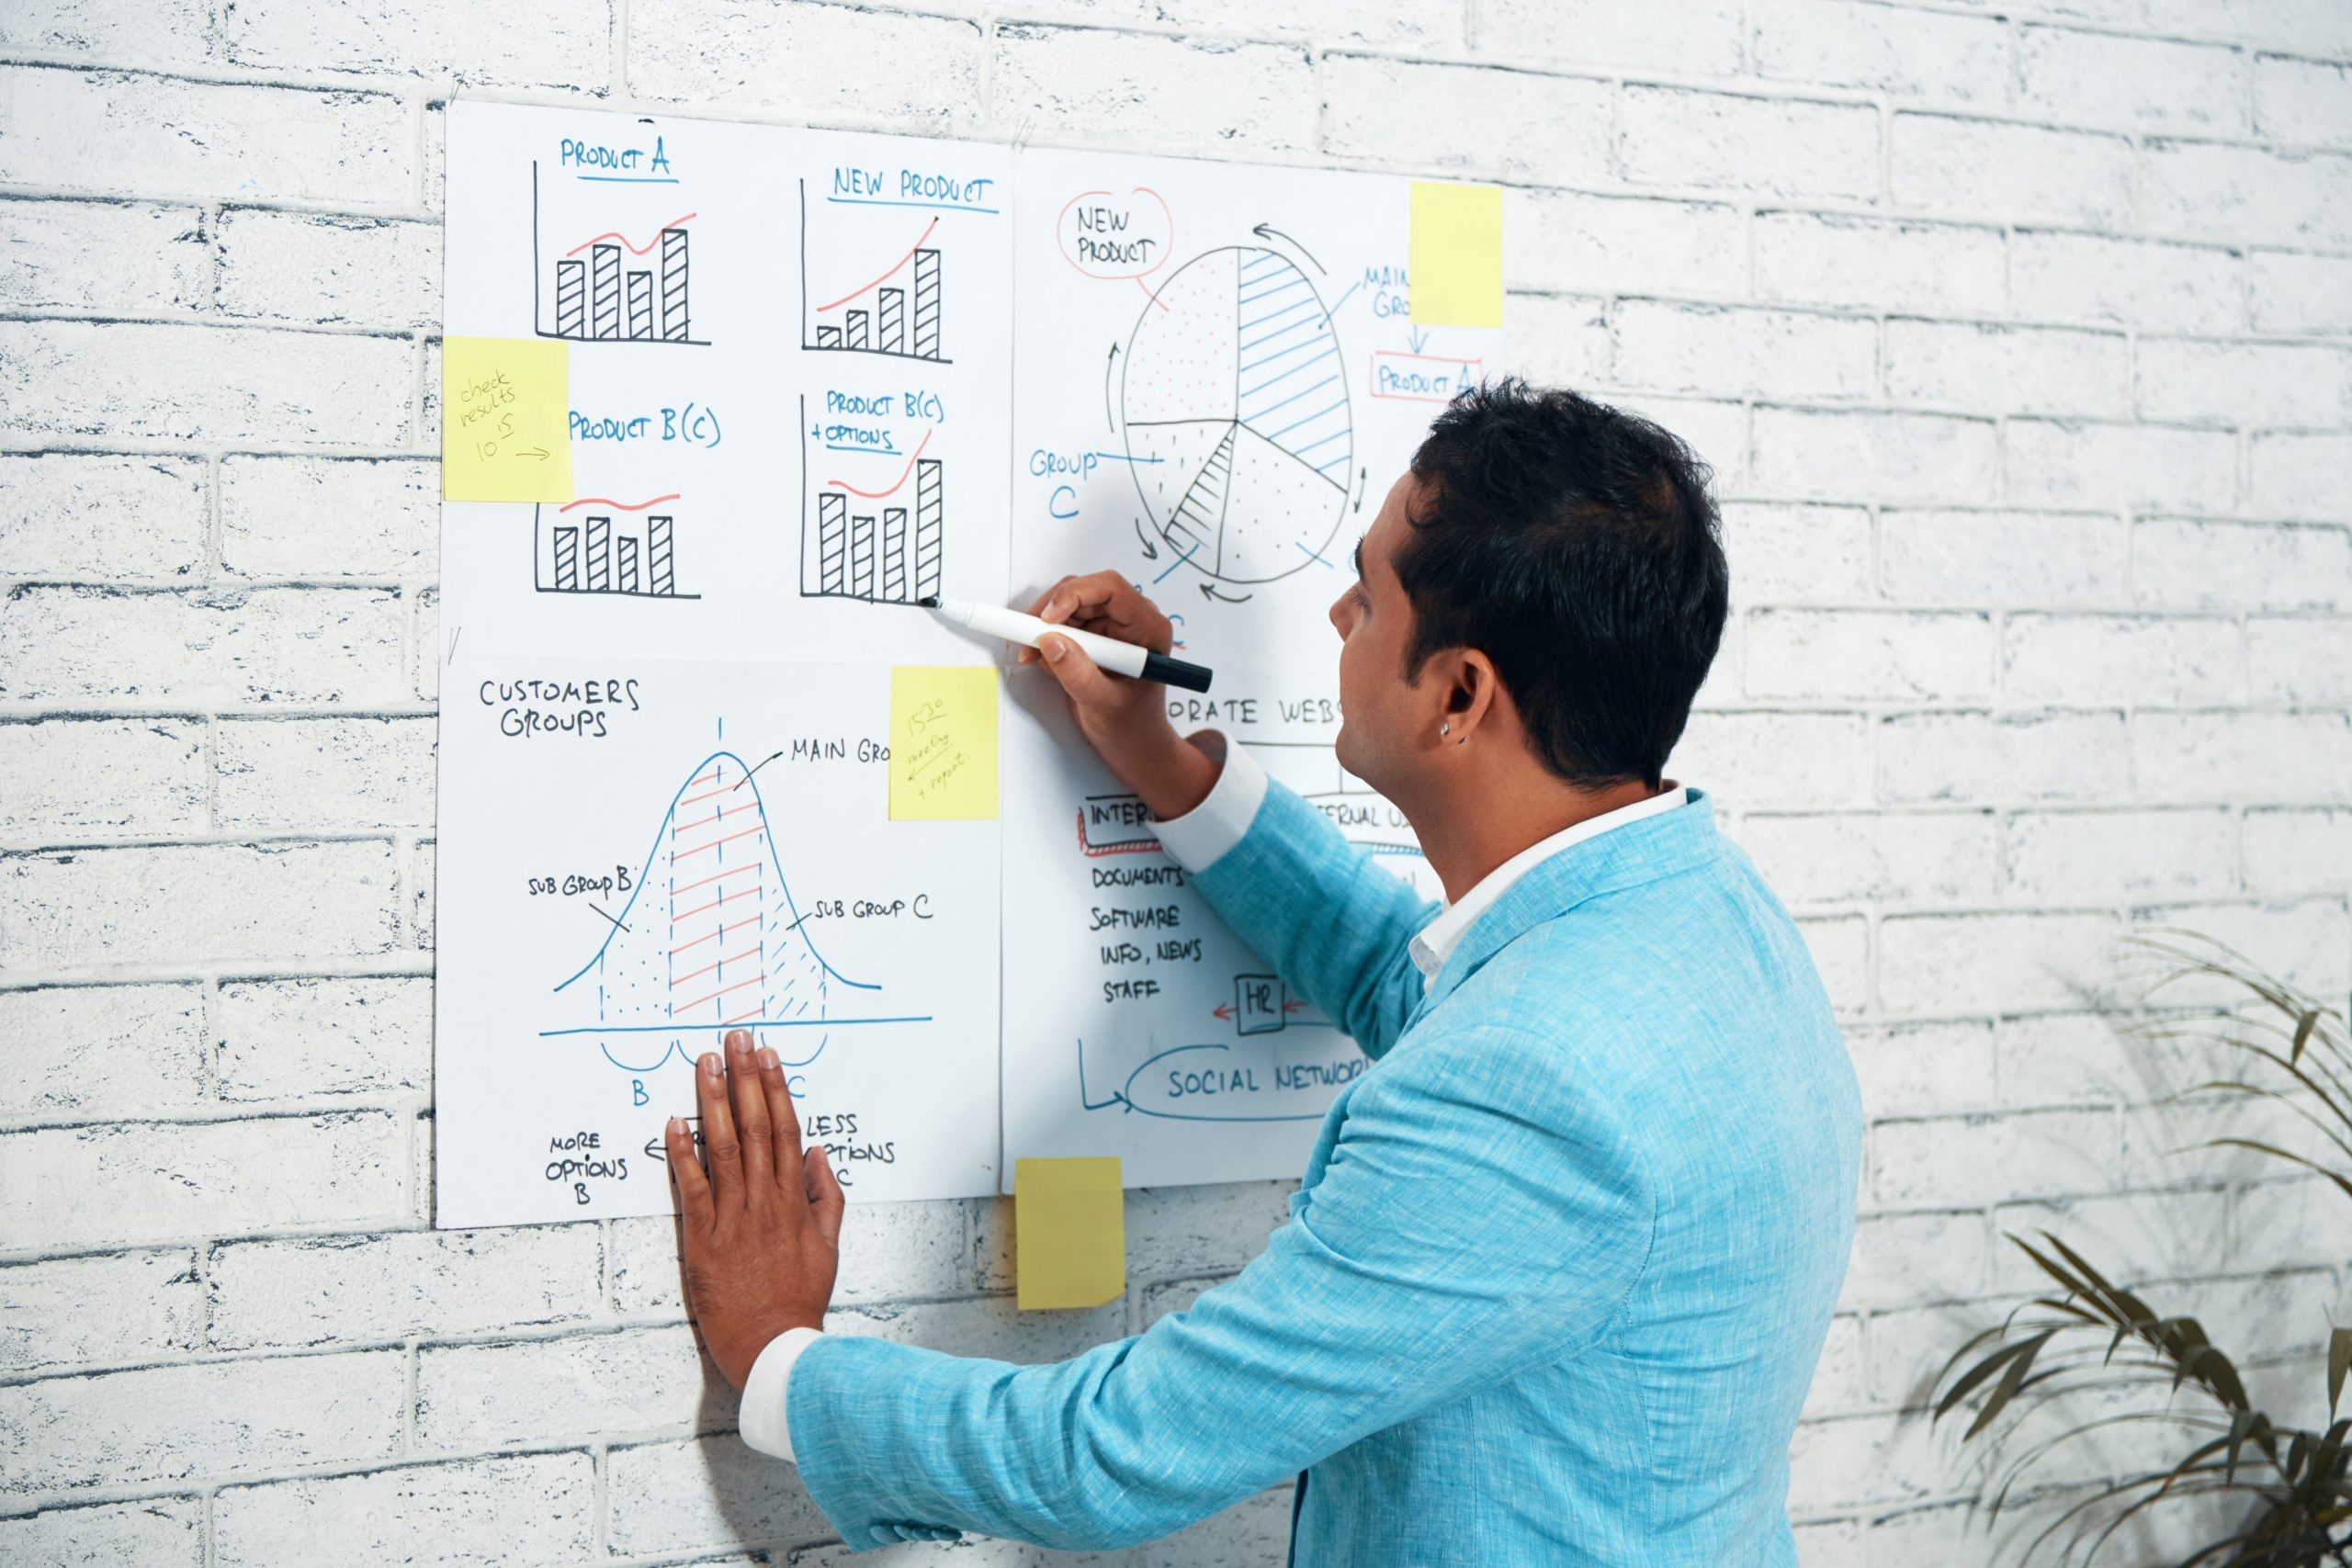

SOFT SKILLS
Analytical
thinking
Problem solving
Innovation
Creativity

Slide 16
Ben in the future

Slide 17

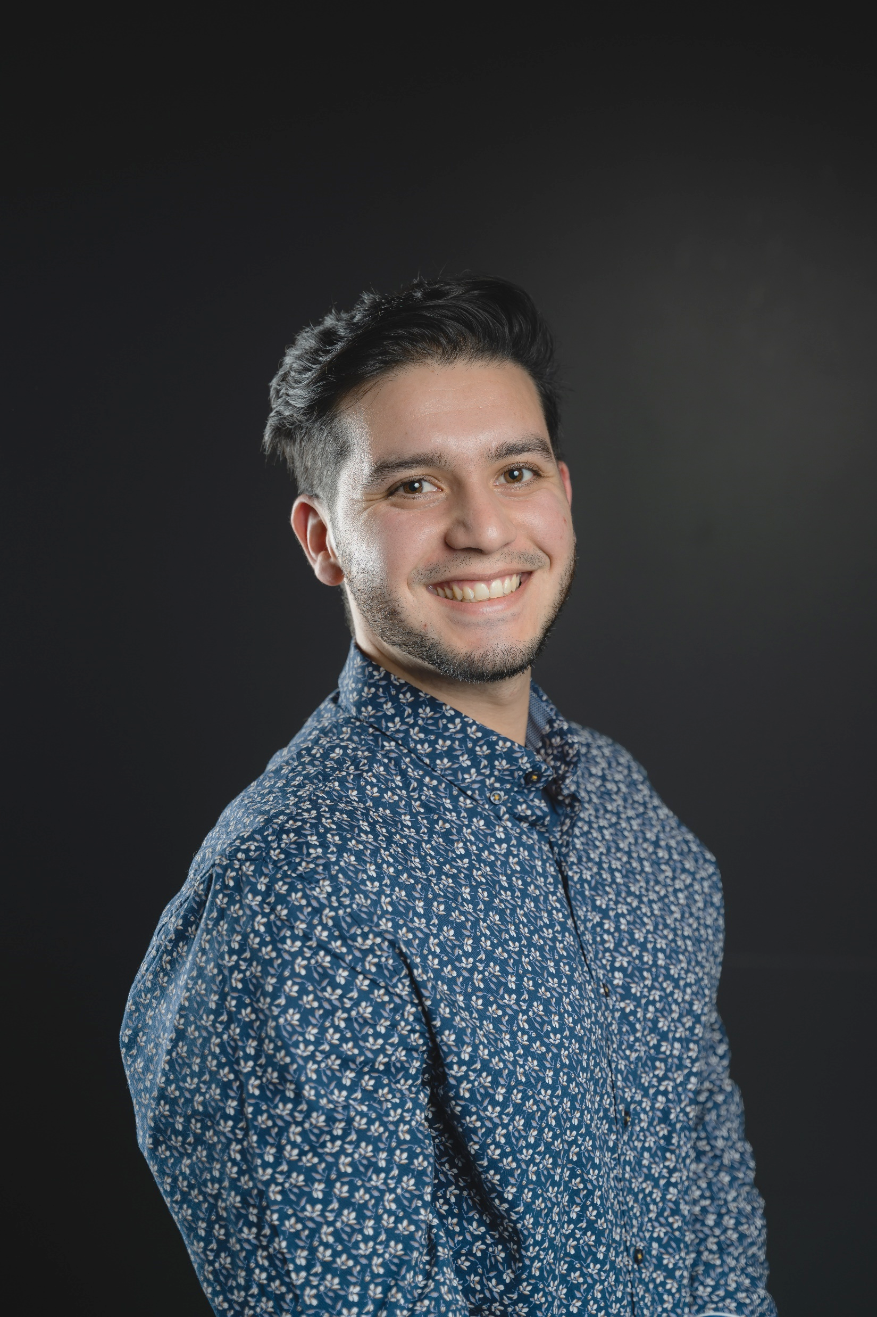

Ben in the future

Slide 18


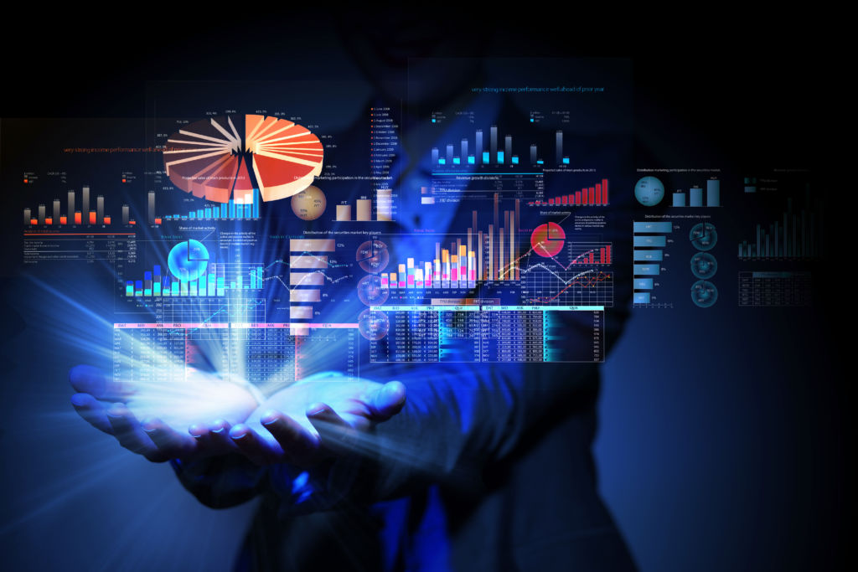
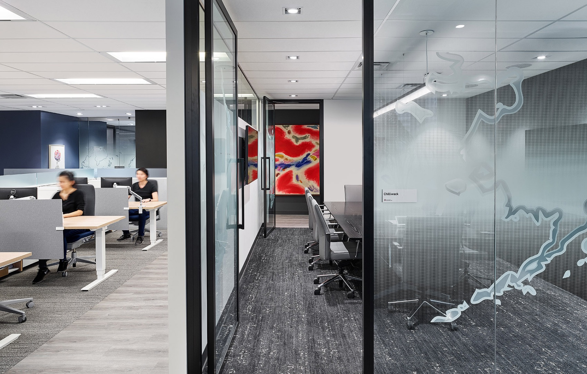


Ben in the future
Working with a team, pursuing goals and achievements
Conducting Data Analyisis with aim to get interesting insights in order to produce Actions
Working in a Canadian Company
Contribute with my Ideas and Creativity to the Canadian Business Market

Slide 19
Thank You!

